Slide 1
Object Oriented Testing

Slide 2
Object oriented concepts
What is object orientation?
Why is it becoming important and relevant in software development?
Is it a buzzword?
  Many developers are of the view that structural programming, modular design concepts, conventional development approaches are old fashioned activities and may not be able to handle today’s challenges.
  They may also feel that real world situations are effectively handled by object oriented concepts using modeling in order to understand them clearly.
  Modeling may improve the quality of SRS document, SDD document and may help us to produce good quality maintainable software.
Copyright © Prof. Yogesh Singh

Slide 3

What is Object Orientation?
Suppose we want to send a book to a teacher
Go to near by courier
Ask to deliver the book to teacher
Give the specified address
Agents of courier will perform the job
Many ways to send a book
  Train network
  Bus network
  Air network
Copyright © Prof. Yogesh Singh

Slide 4
Classes & Objects
All courier types may be combined to form a group called class.
All objects are instances of a class.
The class describes the structure of the instance which include behaviour and information.
Class
Courier
Courier
Say book
Courier
Say
flowers
Courier
Say
Pen
Object1
Object2
Object3
Copyright © Prof. Yogesh Singh

Slide 5
Classes & Objects
A set of objects with similar behaviour & information may constitute a class.
Hence, an object has a state (information) and it offers number of operations (behaviour) depending upon its class.
Copyright © Prof. Yogesh Singh

Slide 6
Classes & Objects
A class represents a template for several objects and describes how these objects are structured internally. Objects of the same class have the same definition both for their operations and for their information structures.
An instance is an object created from a class. The class describes the (behaviour & information) structure of the instance, which the current state of the instance is defined by the operations performed on the instance.
An attribute (or information / state) is a data value held by the object of a class.
Operations (or behaviour) are the functions which may be applied on a class.
Copyright © Prof. Yogesh Singh

Slide 7
Classes & Objects
Courier
Class name
Description
Length
Width
Height
Delivered
Recipientaddress
Attributes
addcourierdetail()
delelecourier()
updatecourier()
getstatus()
Courier Class
Operations
Copyright © Prof. Yogesh Singh

Slide 8
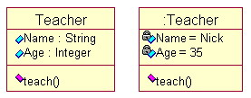
Classes & Objects
Copyright © Prof. Yogesh Singh

Slide 9
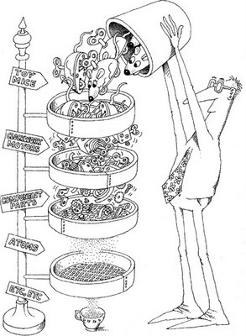
Inheritance
We may organize our knowledge in terms of hierarchy of categories.
All classes inherit information from the upper classes.
Each derived class inherits the attributes of its base class and this process is known as inheritance. In general, low level classes (known as subclasses or derived classes) inherit state and behaviour from their high level class (known as a super class or base class).
Copyright © Prof. Yogesh Singh

Slide 10
Inheritance
Globe
Nation
Company
Courier Company
Fast Track
Courier
The categories around fast track courier
Copyright © Prof. Yogesh Singh

Slide 11
Globe
Nation
Sea
Company
Roads
States
Transport Company
Courier Company
Automobile Company
Aircraft Company
Fast Track Courier
Air World Courier
Express Courier
A Class hierarchy

Slide 12
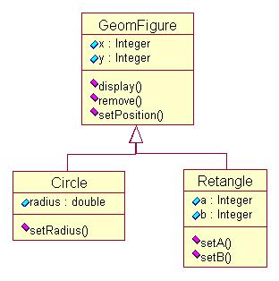
Inheritance
Copyright © Prof. Yogesh Singh

Slide 13
Messages
Objects communicate through passing messages.
A message is a request for performing an operation by some object in the system.
A message may consist of the identification of the target object, name of the requested operation and other relevant information for processing the request.
An object which originates a message is called the sender and the object which receives a message is called the receiver.
Copyright © Prof. Yogesh Singh

Slide 14
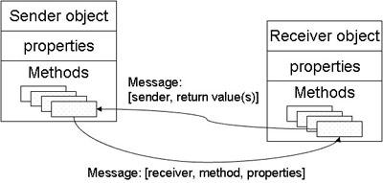
Message Exchange in Classes
Copyright © Prof. Yogesh Singh

Slide 15
Method
A ‘method’ is the sequence of steps (or set of operations) to be performed to fulfill the assigned task.
For example, four methods ‘addcourierdetails’, ‘deletecourier’, ‘updatecourier’, and ‘viewstatus’ are implemented in courier class.
There may be many methods available for any task. It is the responsibility of receiver of the message to choose an appropriate method to complete task effectively & efficiently.
‘viewstatus’ method must be invoked in order to retrieve the delivery status of the courier.
Copyright © Prof. Yogesh Singh

Slide 16
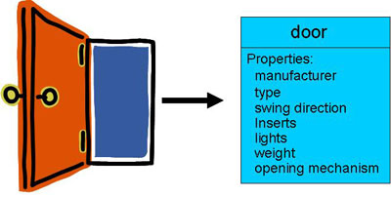
Data Abstraction
Data abstraction is to collect essential elements composing to a compound data.
Copyright © Prof. Yogesh Singh

Slide 17
Encapsulation
Encapsulation is also known as information hiding concept.
It is a way in which both data and functions (or operations) that operate on data are combined under a single unit.
The only way to access the data is through functions, which operate on the data.
The data is hidden from the external world. Hence, it is safe from outside (external) and accidental modifications. For example, any object will have attributes (data) and operations which operates on the specified data only.
Copyright © Prof. Yogesh Singh

Slide 18
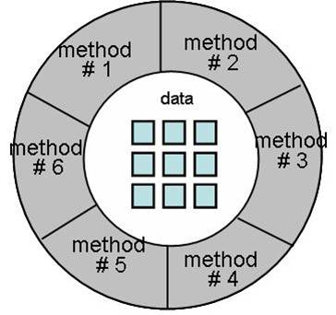
Encapsulation
Copyright © Prof. Yogesh Singh

Slide 19
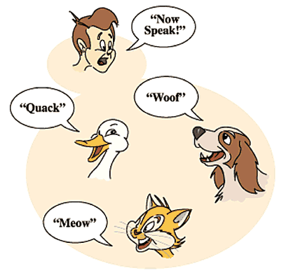
Polymorphism
Copyright © Prof. Yogesh Singh

Slide 20
Polymorphism
The dictionary meaning of polymorphism is “many forms”.
In the real world, the same operations may have different meanings in different situations.
Same message is sent to different objects irrespective of their class, but the responses of objects may be different.
Copyright © Prof. Yogesh Singh

Slide 21
Polymorphism
Polymorphism is considered to be an important concept of any object oriented programming languages.
    As we all know, arithmetic operators such as +, =, - are used to operate on primary data types such as int, float etc.
    We may overload these operators so that they may operate in the same way on objects (user defined data types) as they operate on primary data types.
    Thus, the same operators will have multiple forms.
Copyright © Prof. Yogesh Singh

Slide 22
Object Oriented Testing
Object-oriented programming language features of inheritance and polymorphism present new technical challenges to testers.
Focus is on objects instead of functions.
Copyright © Prof. Yogesh Singh

Slide 23
Activity Diagrams
An activity diagram is the notation for an activity graph.
Activity diagrams describe the workflow behavior of a system.
An activity state is shown as a box with rounded ends containing a description of the activity. (Normal state boxes have straight sides and rounded corners.)
Simple completion transitions are shown as arrows.
Branches are shown as guard conditions on transitions or as diamonds with multiple labeled exit arrows.
Copyright © Prof. Yogesh Singh

Slide 24
Activity Diagrams
How to Draw: Activity Diagrams
Activity diagrams show the flow of activities through the system.
Diagrams are read from top to bottom and have branches and forks to describe conditions and parallel activities.
A fork is used when multiple activities are occurring at the same time.
The diagram below shows a fork after activity1.
This indicates that both activity2 and activity3 are occurring at the same time. After activity2 there is a branch.
The branch describes what activities will take place based on a set of conditions.
All branches at some point are followed by a merge to indicate the end of the conditional behavior started by that branch.
After the merge all of the parallel activities must be combined by a join before transitioning into the final activity state.
Copyright © Prof. Yogesh Singh

Slide 25
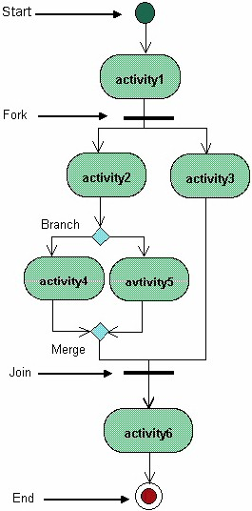

Slide 26
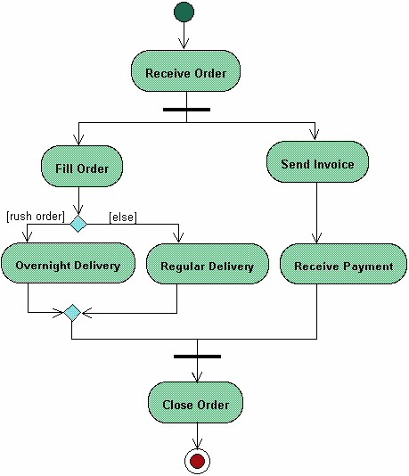
The diagram shows the flow of actions for processing an order workflow.
Once the order is received the activities split into two parallel sets of activities.
One side fills and sends the order while the other handles the billing.
On the Fill Order side, the method of delivery is decided conditionally.
Depending on the condition either the Overnight Delivery activity or the Regular Delivery activity is performed.
Finally the parallel activities combine to close the order.
¹

Slide 27
Path Testing
Draw activity diagram for each method in the class.
Calculate cyclomatic complexity of the activity diagram corresponding to each method.
Construct test cases for each independent path in the activity diagram such that each transition in the diagram is traversed at least once.
Copyright © Prof. Yogesh Singh

Slide 28
Path Testing
Consider the program (written in C++) for determination of division of a student given marks in three subjects. There are three methods in this program getdata, validate and calculate. Design test cases for validate and calculate methods of the class using path testing.
Copyright © Prof. Yogesh Singh

Slide 29
Path Testing
#include<iostream.h>
#include<conio.h>
class student
{
int mark1;
int mark2;
int mark3;
Copyright © Prof. Yogesh Singh

Slide 30
Path Testing
public:
void getdata()
{
cout<<"Enter marks of 3 subjects (between 0-100)\n";
cout<<"Enter marks of first subject:";
cin>>mark1;
cout<<"Enter marks of second subject:";
cin>>mark2;
cout<<"Enter marks of third subject:";
cin>>mark3;
}
Copyright © Prof. Yogesh Singh

Slide 31
Path Testing
void validate()
{
if(mark1>100||mark1<0||mark2>100||mark2<0||mark3>100||mark3<0){
cout<<"Invalid Marks! Please try again";
}
else{
calculate();
}
}
void calculate();
};
Copyright © Prof. Yogesh Singh

Slide 32
Path Testing
[mark1>100||mark1<0||mark2>100||mark2<0||mark3>100||mark3<0]
Invalid Marks! Please try again
calculate()
Copyright © Prof. Yogesh Singh

Slide 33
Path Testing
Cyclomatic complexity = e-n+2P =transitions – activities/branches +2P
= 5 – 5 +2
= 2
Test case | mark1 | mark2 | mark3 | Path
1 | 101 | 40 | 50 | Invalid marks
2 | 90 | 75 | 75 | calculate()
Copyright © Prof. Yogesh Singh

Slide 34
Path Testing
void student::calculate()
{
int avg;
avg=(mark1+mark2+mark3)/3;
if(avg<40) {
cout<<"Fail";
}
else if(avg>=40&&avg<50){
cout<<"Third Division";
}
else if(avg>=50&&avg<60){
cout<<"Second Division";
}
else if(avg>=60&&avg<75){
cout<<"First Division";
}
else{
cout<<"First Division with Distinction";
}
}
Copyright © Prof. Yogesh Singh

Slide 35
Path Testing
Copyright © Prof. Yogesh Singh

Slide 36
int avg;
avg=(mark1+mark2+mark3)/3;
[avg<40]
Fail
[avg>=40&&avg<50]
Third division
[avg>=50&&avg<60]
Second division
[avg>=60&&avg<75]
First division
First division with distinction

Slide 37
Path Testing
Cyclomatic complexity = e-n+2P
= 15 – 12 + 2
= 5
Test case | mark1 | mark2 | mark3 | Path
1 | 40 | 30 | 40 | Fail
2 | 45 | 47 | 48 | Third division
3 | 55 | 57 | 60 | Second division
4 | 70 | 65 | 60 | First division
5 | 80 | 85 | 78 | First division with distinction
Copyright © Prof. Yogesh Singh

Slide 38
State-Based Testing
This testing technique was developed for object-oriented systems.
State-based testing compares the resulting state of the system with the expected state.
In the context of a class, state-based testing consists of deriving test cases from the UML statechart diagram for the class.
Copyright © Prof. Yogesh Singh

Slide 39
State-Based Testing
State Transition Diagrams
A state transition diagram is a graphic representation of a state machine.
Nodes represent states.
Arrows (directed edges ) represent transitions.
The annotations on the edges represent events and actions.
Alpha and Omega are two special states used to represent constructor and destructor of a class.
Copyright © Prof. Yogesh Singh

Slide 40
State-Based Testing
Consider the state model for class stack.
There are three states:
Empty
Holding
Full
There are four events:
New
Push
Pop
Destroy
Copyright © Prof. Yogesh Singh

Slide 41
State-Based Testing
alpha
new
Empty
push(x)
[top<max-1]
push(x)
Holding
[top>1]
pop()
[top=1]
pop()
pop()
[top=max-1]
push(x)
Full
omega
destroy
Copyright © Prof. Yogesh Singh

Slide 42
State-Based Testing
Event Descriptions
New: A new instance is created (constructor called)
Push: x element is inserted in the stack.
Pop: current element is removed from the stack.
Destroy: the instance of stack class are destroyed.
Copyright © Prof. Yogesh Singh

Slide 43
State-Based Testing
State Transition Table
State transition diagram can be used in modeling problems with small number of states.
State transition tables provide a compact representation and ease systematic examination and use of the model.
In state transition tables, rows represent current acceptable states and column represent resultant state.
Copyright © Prof. Yogesh Singh

Slide 44
State-Based Testing
state | Event/method | Resultant state
 |  | Alpha | empty | holding | full | omega
alpha | new |  | √
 | push(x)
 | pop()
 | destroy
empty | new
 | push(x) |  |  | √
 | pop()
 | destroy |  |  |  |  | √
Copyright © Prof. Yogesh Singh

Slide 45
State-Based Testing
state | Event/method | Resultant state
 |  | Alpha | empty | holding | full | omega
Holding | new
 | push(x) |  |  | √ | √
 | pop() |  | √ | √
 | destroy |  |  |  |  | √
Full | new
 | push(x)
 | pop() |  |  | √
 | destroy |  |  |  |  | √
Copyright © Prof. Yogesh Singh

Slide 46
State-Based Testing
The FREE State Model
The flattened Regular Expression (FREE) state model was developed to provide a testable model of class behavior.
The class under test is flattened to represent the behavior of inherited features.
Copyright © Prof. Yogesh Singh

Slide 47
State-Based Testing
Response Matrix
The FREE model requires a response specification for all event/state pairs so that all event responses may be tested.
Copyright © Prof. Yogesh Singh

Slide 48
State-Based Testing
Response Codes for Illegal Events
Response codes | Name | Response
0 | accept | Performs the explicitly specified transition
1 | Queue | Place the illegal event in a queue for subsequent evaluation and ignore.
2 | Ignore | No action or state change is to be produced, no error is returned, no exception raised
3 | Flag | Return a nonzero error code.
4 | Reject | Raise an IllegalEventException
5 | Mute | Disable the source of the event and ignore.
6 | Abend | Invoke abnormal termination services and halt the process.
Copyright © Prof. Yogesh Singh

Slide 49
State-Based Testing
Event and guards |  | Accepting state/Expected Response
 |  | Alpha | empty | holding | full | omega
New |  | √ | 6 | 6 | 6 | 4
Push(x) | Top=0 |  | √ | 4 | 4 | 4
 | Top<=max-1 |  | 4 | √ | 4 | 4
Pop() | Top<max |  | 4 | √ |  | 4
 | Top=max |  | 4 | 4 | √ | 4
destroy |  |  | √ | √ | √ | 4
Response Matrix for Stack
Copyright © Prof. Yogesh Singh

Slide 50
State-Based Testing
Test strategies
Exhaustive: every path once the state transition diagram is examined at least once
  Usually totally impossible or at least impractical
All-transitions: each transition is exercised at least once
  Implies all events coverage all states coverage, and all actions coverage.
All round-trip paths: generated by N+ test strategy.
Copyright © Prof. Yogesh Singh

Slide 51
State-Based Testing
N+ test strategy for state based testing
N+ test strategy is demonstrably more powerful than simpler state-based strategies.
Generate the round-trip path tree
This tree includes all round-trip paths:
  Transition sequence that begin and end with the same state and simple paths from the initial to final state.
Copyright © Prof. Yogesh Singh

Slide 52
State-Based Testing
Transition Tree Algorithm
Initial state in the root node of the tree
  Use the alpha state if multiple constructors produce behaviorally different initial states.
For each non-terminal leaf node in the tree:
  Draw a new edge for every transition out of the initial node, with nodes being added for resultant states.
For each edge and node drawn in step 2:
  Copy the corresponding transition event/action to the new edge.
  If the state this node represents is already represented by another node or is a final state this node is terminal.
Repeat steps 2 and 3 until all leaf nodes are marked terminal.
Copyright © Prof. Yogesh Singh

Slide 53
State-Based Testing
[top=1] pop()
new
push(x)
Empty
alpha
Empty
Holding
[top>1] pop()
Holding
[top<max-1] push(x)
Holding
[top=max-1] push(x)
destroy
Pop()
Holding
Transition tree for stack
Full
omega
omega
Copyright © Prof. Yogesh Singh

Slide 54
State-Based Testing
Test case generation
Each test case begins at the root and ends at the leaf node.
There are 6 paths.
The expected results are the sequence of states and actions which corresponds to the events on the test sequence.
Copyright © Prof. Yogesh Singh

Slide 55
State-Based Testing
Test case id | Test case input |  | Expected result
 | Event (method) | Test condition | action | State
1.1 | New |  |  | Empty
1.2 | Push(x) |  |  | Holding
1.3 | Pop() | Top=1 | Return x | Empty
2.1 | New |  |  | Empty
2.2 | Push(x) |  |  | Holding
2.3 | Pop() | Top>1 | Return x | holding
3.1 | New |  |  | Empty
3.2 | Push(x) | Top<max-1 |  | Holding
3.3 | Push(x) |  |  | holding
Copyright © Prof. Yogesh Singh

Slide 56
State-Based Testing
Test case id | Test case input |  | Expected result
 | Event (method) | Test condition | action | State
4.1 | New |  |  | Empty
4.2 | Push(x) |  |  | Holding
4.3 | Push(x) | Top=max-1 |  | Full
4.4 | Pop() |  |  | Holding
5.1 | New |  |  | Empty
5.2 | Push(x) |  |  | Holding
5.3 | Push(x) | Top=max-1 |  | Full
5.4 | destroy |  |  | omega
6.1 | New |  |  | empty
6.2 | destroy |  |  | Omega
Copyright © Prof. Yogesh Singh

Slide 57
State-Based Testing
Test case id | Test condition |  | Expected result
 | Test state | Test event | Code | action
7.0 | Empty | New | 6 | Abend
8.0 | Empty | Pop() | 4 | Illegal exception
9.0 | Holding | New | 6 | Abend
10.0 | Holding | Push (top=max) | 4 | Illegal exception
11.0 | Holding | Pop (top=0) | 4 | Illegal exception
12.0 | Full | New | 6 | Abend
13.0 | Full | Push | 4 | Illegal exception
14.0 | 0mega | any | 4 | Illegal exception
Copyright © Prof. Yogesh Singh

Slide 58
Class Testing
Class Testing
The fundamental unit of an object-oriented program is a class.
Class testing comprises those activities associated with verifying that the implementation of a class corresponds exactly with the specification for that class. If an implementation is correct, then each of the class's instances should behave properly.
Class testing is roughly analogous to unit testing in traditional testing processes and has many of the same problems that must be addressed.
Copyright © Prof. Yogesh Singh

Slide 59
Class Testing
Ways to test a Class
The code for a class can be tested effectively by review or by executing test cases. Review is a viable alternative to execution-based testing in some cases, but has two disadvantages over execution-based testing:
Reviews are subject to human error.
Reviews require considerably more effort with respect to regression testing, often requiring almost as many resources as the original testing.
While execution-based testing overcomes these disadvantages, considerable effort can be required for the identification of test cases and the development of test drivers.
Copyright © Prof. Yogesh Singh

Slide 60
Class Testing
Who
Classes are usually tested by its developer, just as subprograms traditionally are unit tested by their developer.
What
We primarily want to ensure that the code for a class exactly meets the requirements set forth in its specification.
When
A test plan— or at least some form of identification of test cases— should be developed soon after a class is fully specified and ready for coding. This is particularly true when a class's developer is also responsible for its testing because early identification of test cases will help a developer to understand the specification and, as we mentioned, get feedback from an independent review.
Copyright © Prof. Yogesh Singh

Slide 61
Class Testing
How
Classes are usually tested by developing a test driver that creates instances of the class and sets up a suitable environment around those instances to run a test case.
How much
We want to test operations and state transitions in all sorts of combinations.
Copyright © Prof. Yogesh Singh

Slide 62
Class Testing
Stack
X: integer Top: integer
Stack() Push(x) Pop()
Specification for the stack class
Copyright © Prof. Yogesh Singh

Slide 63
Class Testing
Pre-conditions and post conditions
stack::stack()
  Pre=true
  Post: top=0
Stack::push(x)
  Pre: top<MAX
  Post: top=top+1
Stack::pop()
  Pre: top>-1
  Post: top=top-1
Copyright © Prof. Yogesh Singh

Slide 64
Class Testing
Identifying test cases for stack::push(x)
(top<MAX, top=top+1)
(not (top<MAX), exception)
Test input | Condition | Expected output
23 | Top<MAX | Element ’23’ inserted successfully
34 | Top=MAX | Stack overflow
Copyright © Prof. Yogesh Singh

Slide 65
Class Testing
Identifying test cases for stack::pop()
(top>0, top=top-1)
(not (top>0), exception)
Test input | Condition | Expected output
- | Top>0 | 23
- | Top=0 | Stack underflow
Copyright © Prof. Yogesh Singh

